Slide 1
Voting Bills Across Red, Blue, and Purple States
A Text Analysis of State Voting Legislation by Political Control
EPPS 6323 — Knowledge Mining
Spring 2026

Slide 2
Introduction
State voting laws have been among the most contested areas of American politics, particularly following the 2020 presidential election. Debates over voter ID, mail ballot procedures, early voting, and certification have split sharply along partisan lines. However most comparative analyses rely on manual review of a limited number of high-profile bills, making systematic cross-state characterization difficult.
This project applies computational text analysis to address three questions:
Language
What vocabulary most distinctively characterizes voting bills under each type of political control?
Themes
Do bills in Republican-, Democratic-, and divided-control states cluster into different policy domains?
Direction
Are bills primarily expanding voter access, restricting it, or making neutral procedural changes — and does this vary by political control?
Political control operationalized as the legislative trifecta: same party controls both legislative chambers and the governorship (Unified Republican | Unified Democratic | Divided Government)

Slide 3
Research Question & Hypotheses
Do voting bills differ systematically in language and direction depending on which party controls the legislature and governorship?
H1
Bill language will differ systematically along ideological lines, states under different partisan control will use measurably distinct vocabulary when addressing voting and election procedures.
H2
Bills introduced in Republican-controlled states will be more restrictive in language and direction than bills introduced in Democratic-controlled or divided-government states.
Political control operationalized as trifecta: Unified Republican | Unified Democratic | Divided Government

Slide 4
Data: Collection & Corpus
State voting bills from the LegiScan public legislative database, 2025–2026 sessions
83
24
51
32
2025–26
Bills collected
States
Usable after extraction
Failed extraction
Sessions
Bill Collection
httr2 · LegiScan API
Table 1. Corpus composition by trifecta group
Retrieved via LegiScan getBill API in two rounds. Round 1: 50 bills with available PDFs. Round 2: 33 additional bills from underrepresented states (IL, CO, CT, MD for Democratic trifecta; PA, WI, NC, NV for divided government) to improve partisan and geographic balance.
Trifecta
Bills
States
Unified Republican
13
MO, OH, NE, UT, KS, IN, OK
Unified Democratic
24
MN, WA, IL, CT, MD, NJ, NM
Divided Government
14
PA, NV, NC, AK, VA, WI
Total
51
17 states
Note: Minnesota accounts for 14 of 24 Democratic-trifecta bills (58%). Democratic findings are partly shaped by Minnesota's distinctive election administration structure (county auditors administer elections) and should be interpreted with this in mind.

Slide 5
Data: Text Extraction & Preprocessing
Converting raw PDFs into an analysis-ready document-feature matrix
PDF Extraction & Attrition
pdftools
Preprocessing Pipeline
quanteda · stringr
83 bills collected
1
Clean
stringr
Removed page numbers, hyphenated line breaks, non-printable characters
51 PDFs yielded text
2
Tokenize
quanteda
32 failed extraction
Lowercased; stripped punctuation, numbers, and URLs
Failed PDFs were predominantly corrupted or near-empty placeholder files (some as small as 98 bytes) — likely a source-database quality issue, not a processing error. Whether excluded bills differ systematically from included bills is unknown; this is a study limitation.
3
Stem
quanteda
Porter stemmer applied to reduce words to root forms
4
Filter
quanteda
Standard English stopwords + legal boilerplate removed (shall, enacted, pursuant, herein, subsection, section, amended…)
Final DFM: 2,589 unique word stems · 51 documents · 268,589 total tokens · Mean bill length: 5,266 tokens (range: 67–22,444)

Slide 6
How We Analyzed the Bills
Three analytical steps — each answers a different question about the text
Which words stand out?
1
We measured which words each political group uses more than the others. Words that appear equally across all three groups are ignored — only vocabulary that is distinctive to one group gets highlighted.
What policy areas emerge?
2
We let the computer group bills by the language they share — without telling it anything about party or politics. Four natural clusters emerged. We then read the top words in each cluster and named the themes ourselves.
Is the bill expanding or restricting voting?
3
We fed each bill to an AI model and asked it to classify the bill as Restrictive, Expansive, or Neutral based on a clear ruleset. The AI also explained its reasoning for each decision.
The first two steps discover patterns on their own — no political labels were used until the very end, when we compared findings across groups.

Slide 7
How We Classified Each Bill
An AI model read every bill and applied a consistent three-category ruleset
Each bill was sent to an AI model along with a clear set of rules. The model assigned one label and wrote a short explanation of its decision.
Restrictive
The bill makes it harder to vote — for example, stricter ID requirements, shorter registration windows, or reduced access to mail-in ballots.
Expansive
The bill makes it easier to vote — for example, automatic voter registration, extended early voting hours, or restoring voting rights.
Neutral
The bill makes administrative or procedural changes that don't clearly help or hurt voter access — for example, updating forms or renaming offices.
All 51 bills were classified successfully. The AI also flagged which specific provision drove its decision, making results easy to spot-check.

Slide 8
Checking the AI's Work
A human reviewer independently classified 10 bills to verify the AI's accuracy
How we checked it
Validation Results
We randomly selected 10 bills — drawn from all three political groups — and had a human reviewer classify each one using the same ruleset as the AI. The reviewer did not see what the AI had decided. After coding was complete, we compared the two sets of labels to measure how often they agreed.
Measure
Result
Bills reviewed
10
Agreement
9 out of 10 (90%)
Agreement score (κ)
0.831
What that means
Almost perfect agreement
Where they disagreed
Passed threshold?
Yes (target: ≥ 0.61)
One bill (HB1871, Missouri): the AI called it Restrictive because it added new procedural steps. The human called it Neutral, reading those same steps as routine scheduling changes with no real impact on voters. Both interpretations are defensible — it is a genuine edge case in the ruleset.
A score above 0.81 is considered "almost perfect" agreement — meaning the AI and the human were reading the bills the same way.

Slide 9
Finding 1: Each Group Uses a Different Political Vocabulary
Words most strongly associated with each group — terms common to all three groups are excluded
Republican States
Democratic States
Divided-Gov States
Elector
Auditor
Fiscal
Provision
Minnesota
Factor
Falsif
Roster
Barcode
Circul
Provision
Pool
Signatur
Canvass
Alaska
Township
Revisor
Deficit
Tuesday
Commission
Commonwealth
Word stems shown (e.g. "falsif" = falsification, "circul" = circulation). Bar length is relative to the top term within each group — scores are not comparable across groups. Statutory citation terms (§203B, §204C) and PDF markup artifacts removed.

Slide 10
Finding 2: Republican and Democratic Bills Focus on Different Policy Areas
Four themes emerged from the text — the computer found these patterns without being told what to look for
Election Administration
Share of each theme per group (%)
How elections are run day-to-day: polling places, counting, party primaries
Republican (n=13)
52%
30%
11%
Voter ID & Registration
ID requirements, registration procedures, absentee ballot rules
Democratic (n=24)
20%
56%
20%
Redistricting & Certification
Drawing district boundaries, certifying results, petition processes
Divided (n=14)
21%
12%
12%
55%
Local Government & Procedures
Administrative housekeeping: forms, definitions, local office procedures
Admin
Voter ID
Redistrict.
Local Gov
Republican bills concentrate on election rules and redistricting. Democratic bills are dominated by voter ID and registration. Divided-government states focus on local administrative procedures.

Slide 11
Finding 3: A Clear Partisan Divide in Bill Direction
Every Republican-controlled state bill was classified as Restrictive — Divided states were overwhelmingly Neutral
Unified Republican (n = 13)
100%
Unified Democratic (n = 24)
58%
33%
8%
Divided Government (n = 14)
86%
14%
Overall (n = 51)
53%
39%
8%
Note: Many Democratic "Restrictive" bills are absentee ballot reforms in Minnesota — the AI flags any new procedural requirement as Restrictive regardless of political intent. In context, these represent administrative modernization, not intentional access barriers.
Restrictive
Neutral
Expansive

Slide 12
Finding 4: Who Is Sponsoring These Bills?
Sponsor party reveals minority-party activity — especially in Democratic-controlled states
85%
54%
65%
Republican-sponsored
Republican-sponsored
Democratic-sponsored
in Republican-controlled states (11 of 13 bills)
in Democratic-controlled states (22 of 41 bills)
in Divided-government states (15 of 23 bills)
What this tells us
The high Republican sponsorship rate in Democratic-controlled states shows that minority-party legislators also introduce voting bills — even when those bills are unlikely to pass. LegiScan returns all introduced bills, not just enacted ones, so the corpus captures the full range of legislative intent rather than only successful legislation. Future research should distinguish between bills that were enacted and bills that died in committee, as the direction and content of enacted bills may differ substantially.
Sponsor party identified for 77 of 83 bills. Six bills had no identified primary sponsor in LegiScan.

Slide 13
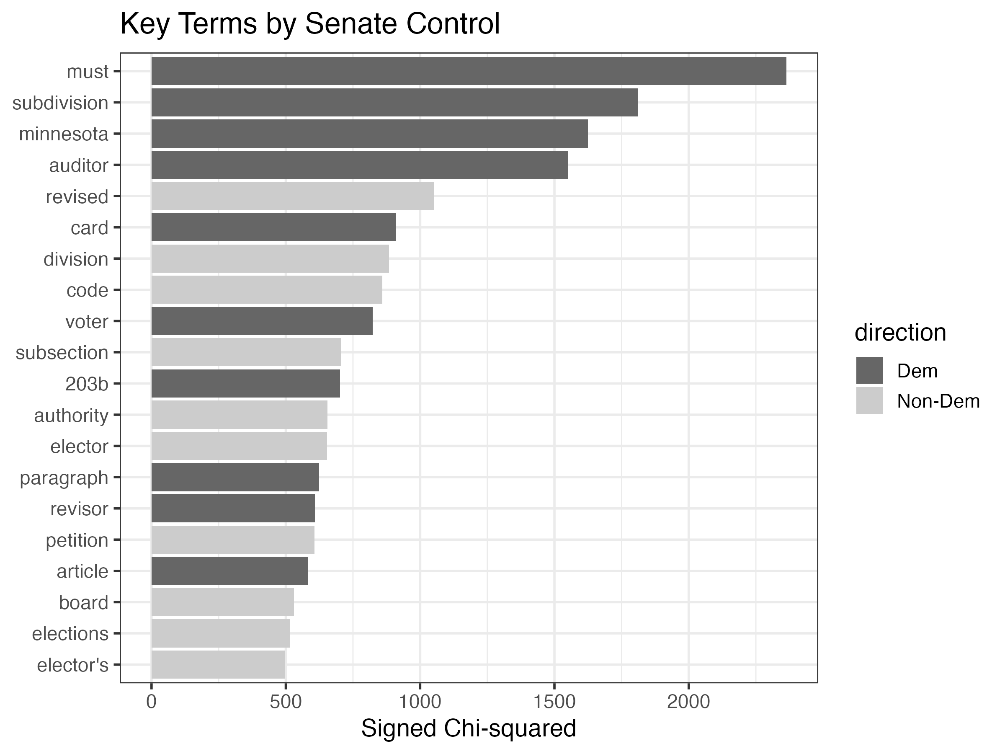
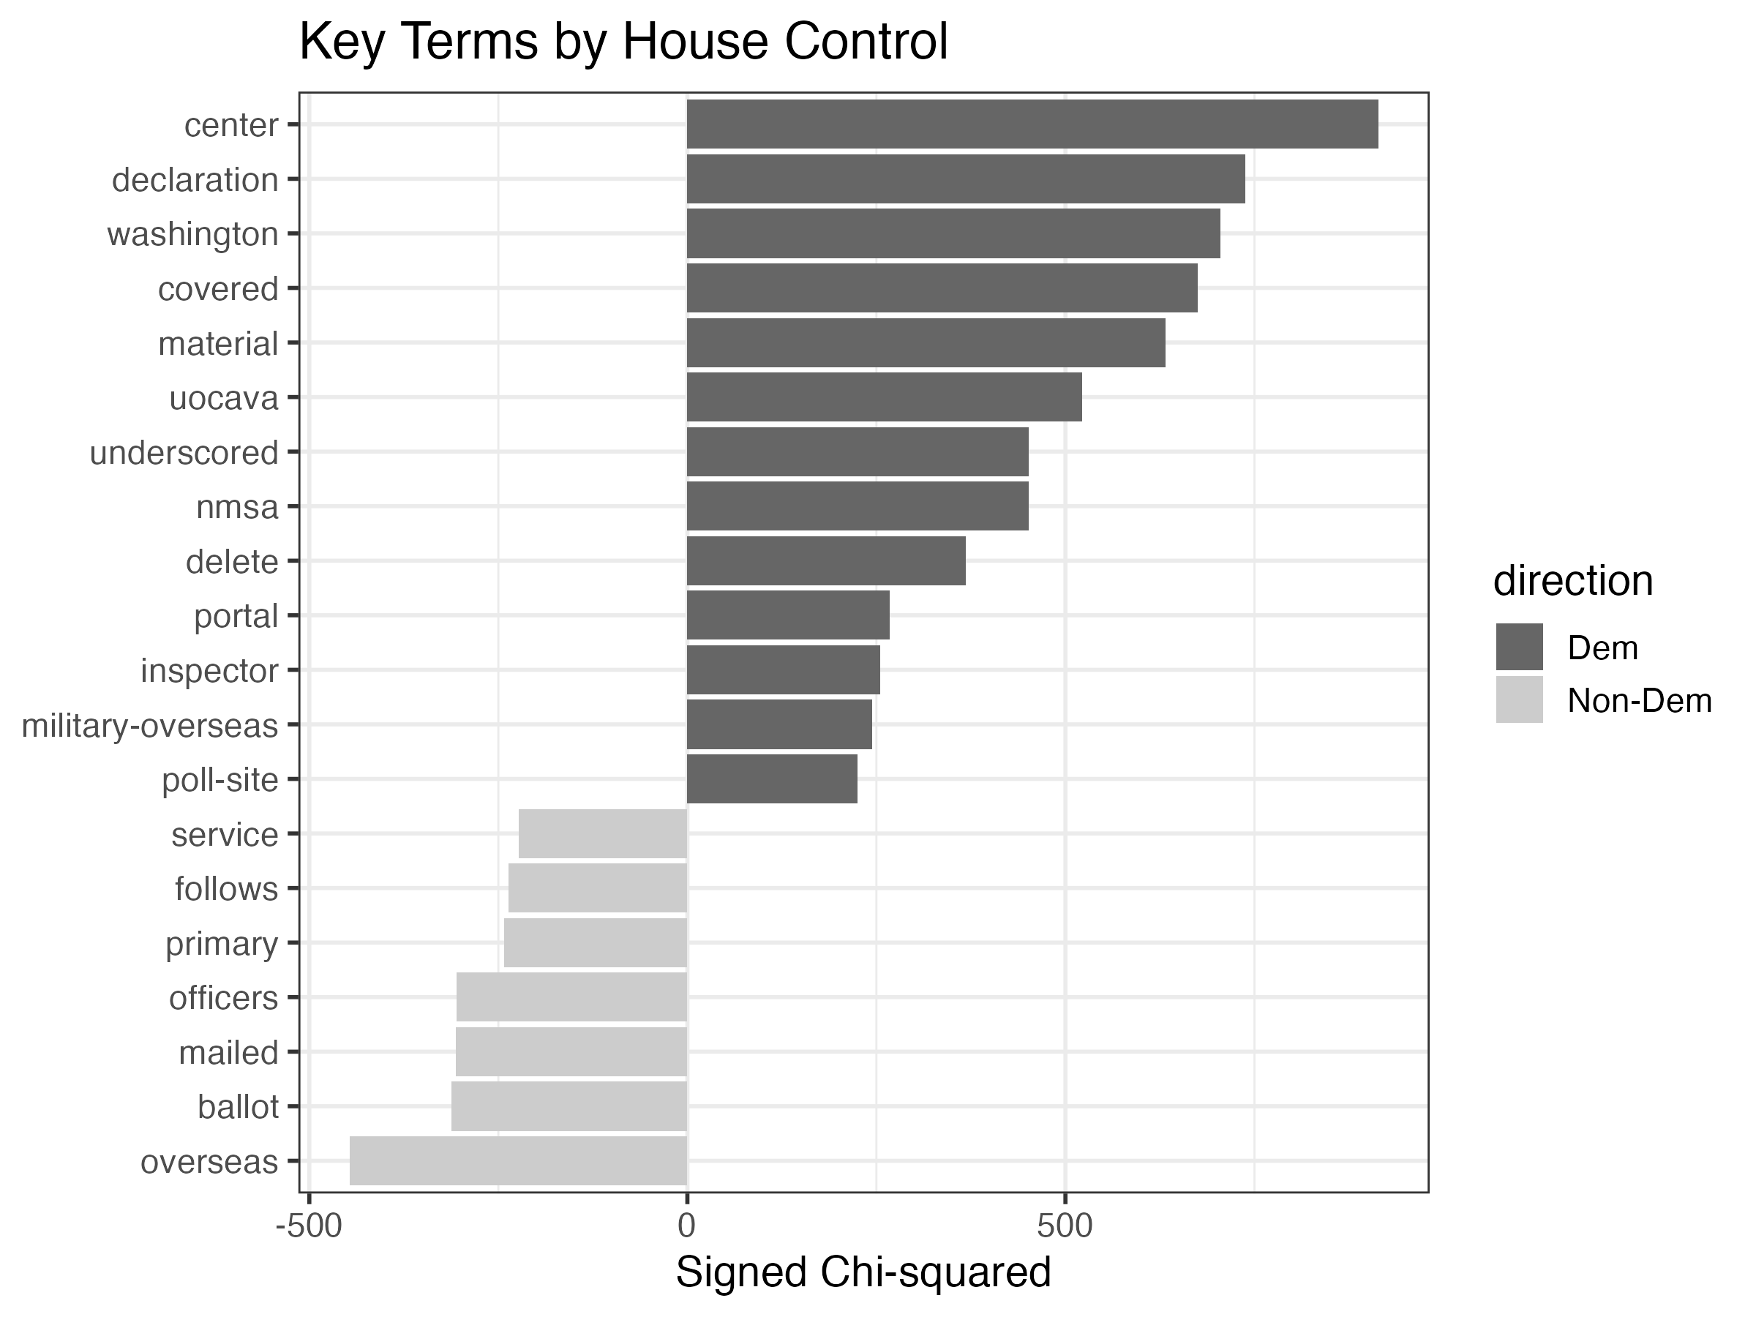
Supplementary: Distinctive Vocabulary by Chamber Control
Keyness analysis using Senate and House Democratic control as the grouping variable (10-state subset)
Senate Democratic Control
House Democratic Control
States coded 1 (Dem control) vs. 0 (non-Dem) for each chamber independently. Subset covers 10 states: AK, KS, MN, MO, NE, NM, OH, OK, UT, WA. Bar direction reflects signed chi-squared — rightward = more frequent in Dem-controlled states.

Slide 14
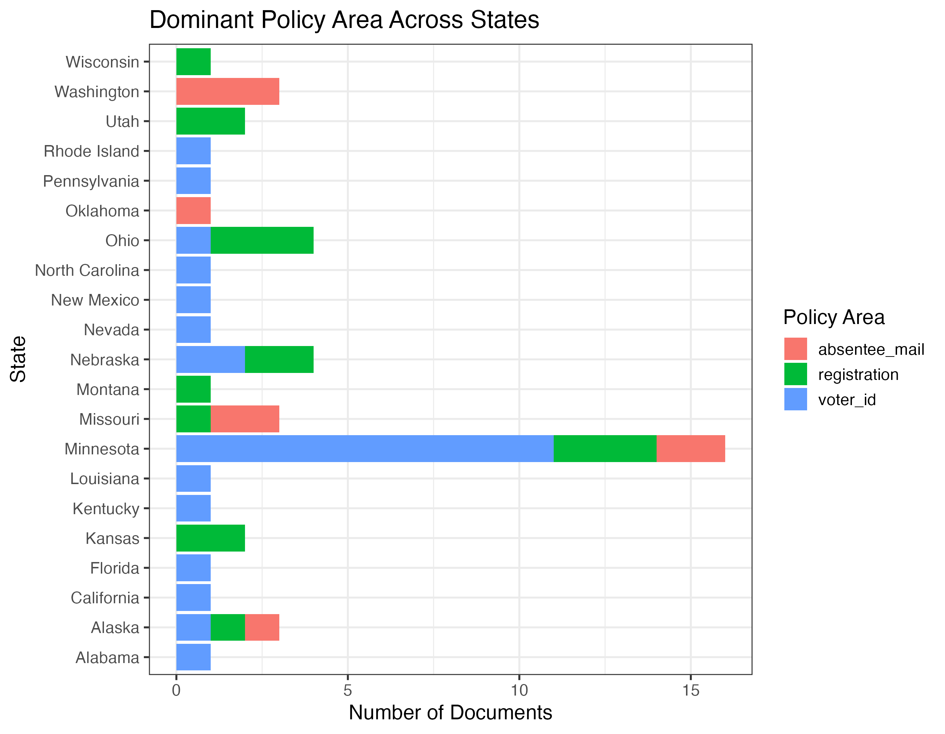
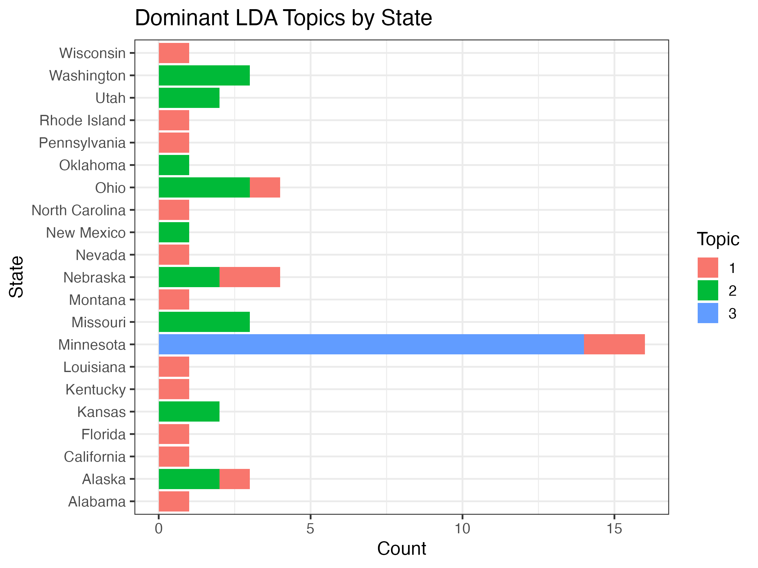
Supplementary: Policy Areas and LDA Topics by State
Dictionary-based policy classification and unsupervised topic modeling (k=3) — LegiscanDraft 1
Dominant Policy Area by State
Dominant LDA Topic by State (k = 3)
Policy dictionary: voter_id · registration · absentee_mail · administration · emergency. LDA topics (k=3): Topic 1 = Administration/Absentee; Topic 2 = Election/Ballot/Board; Topic 3 = Voter ID/Identification/Card. Minnesota dominates Topic 3.

Slide 15
Limitations
Six constraints on how far these findings can be generalized
Small corpus & attrition
Minnesota concentration
51 bills is a thin basis for computational text analysis. Losing 32 of 83 PDFs (39%) to extraction failure introduces potential selection bias — bills with readable text may differ systematically from those without.
58% of Democratic-trifecta bills originate in one state. Minnesota's unique election administration structure (county auditors, distinctive statutes) may inflate the distinctiveness of Democratic vocabulary rather than reflecting Democratic ideology broadly.
Introduced vs. enacted bills
AI rubric boundary cases
The corpus includes all introduced bills regardless of passage status. Bills that actually became law may differ in direction and content from the full introduced corpus.
The classifier labels any bill adding new procedural requirements as Restrictive — regardless of political intent. Administrative modernization bills may be mislabeled. Human validation (κ = 0.831) suggests this is isolated to edge cases.
Single-coder validation
Divided-government heterogeneity
Only one human coder reviewed the 10-bill validation sample. Without a second coder, Human-vs-Human reliability cannot be assessed and the κ estimate lacks a human ceiling benchmark.
14 divided-government bills come from 6 states with different configurations of divided control. Treating all divided arrangements as equivalent may mask within-group variation.

Slide 16
Conclusion: What Did We Find?
Both hypotheses receive support — with important nuance for H2
H1 — Supported
Bill language differs systematically along ideological lines. Republican bills concentrate on elector certification, redistricting, and petition language. Democratic bills are shaped by voter ID, registration, and Minnesota's auditor-based election system. Divided-government bills use generic procedural vocabulary with near-zero distinctive scores.
H2 — Supported (with nuance)
Republican-controlled states produced exclusively Restrictive bills (100%). Divided-government states produced overwhelmingly Neutral bills (86%). Democratic states show 58% Restrictive — but most of this reflects procedural absentee reforms in Minnesota, not intentional access barriers. The directional gradient is clear: Republican > Democratic > Divided in restrictiveness.
Broader takeaway
Political control shapes not only the probability of restrictive voting legislation, but the substantive policy terrain it occupies — the topics bills address, the vocabulary they use, and the direction they push. Computational text analysis can detect these patterns systematically across states and sessions where manual review would be impractical.

Slide 17
AI Collaboration Log
Full documentation of AI tool usage throughout the project — EPPS 6323 requirement
Tools Used
Collaboration Log Summary (7 entries)
Claude Sonnet 4.6
1
Pipeline design & R setup
claude-sonnet-4-6
Pipeline design, R scripting, data collection, preprocessing, visualization, PowerPoint generation
2
Trifecta lookup table
Claude Opus 4.6
3
PDF extraction & DFM
claude-opus-4-6
Bill classification via Anthropic API — 51 bills classified as Restrictive / Expansive / Neutral
4
TF-IDF / keyness analysis
5
LDA topic modeling (K=4)
6
AI bill classification (51 bills)
7
Human validation & kappa
Each log entry documents: tool used · full prompt · AI output · review decision · lesson learned · success flag. Full log available in results/ai_collab_log.md
AI as Research Partner
This project followed the EPPS 6323 "AI as Delegatee" model: research goals were set by the student; AI executed analytical steps under human oversight and review at each stage.

Slide 18
Future Directions
Four extensions that would strengthen and broaden these findings
1
Expand the corpus
2
Disaggregate Minnesota
Collect a larger, nationally representative sample of enacted voting legislation — not just introduced bills — to test whether the directional patterns hold for laws that actually took effect.
Rerun all analyses with Minnesota bills excluded and compared separately. This would reveal whether Democratic findings reflect a genuine ideological pattern or are driven by one state's distinctive legislative volume and structure.
3
Refine the AI rubric
4
Extend to enacted legislation only
Distinguish administrative modernization from intentional access restriction — for example, by adding a sub-category for 'procedural reform' that captures bills adding requirements on election administrators rather than on voters.
Filter the corpus to bills that passed and were signed into law. The directional balance of enacted laws may differ substantially from the full introduced corpus, particularly in divided-government states.
EPPS 6323 — Knowledge Mining | Spring 2026 | Adilene Garibay

